Slide 1
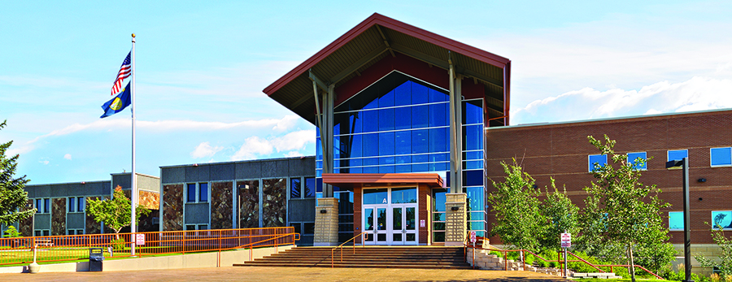
DUAL ENROLLMENT Affiliate Faculty Training 2022

Slide 2
WHY DUAL ENROLLMENT?
Saving Money
1
Saving Time
2
Easing In
3

Slide 3
SAVING MONEY
Montana’s ONE-TWO-FREE Program.
DE students receive “two” courses, up to six college credits, for free.
Cost after free credits are used up?
50% off regular tuition at Great Falls College
Potential savings of $300+ per course.
No fees.

Slide 4
SAVING TIME
College in high school=faster path to a degree in college.
Montana University Core requirements
Foundational courses (ex: Intro to Accounting) that equate to a focused degree/career field
Students can enroll in CTE programs to earn workforce credentials.
Welding DE Cohort
EMT (Emergency Medical Technician) Certification

Slide 5
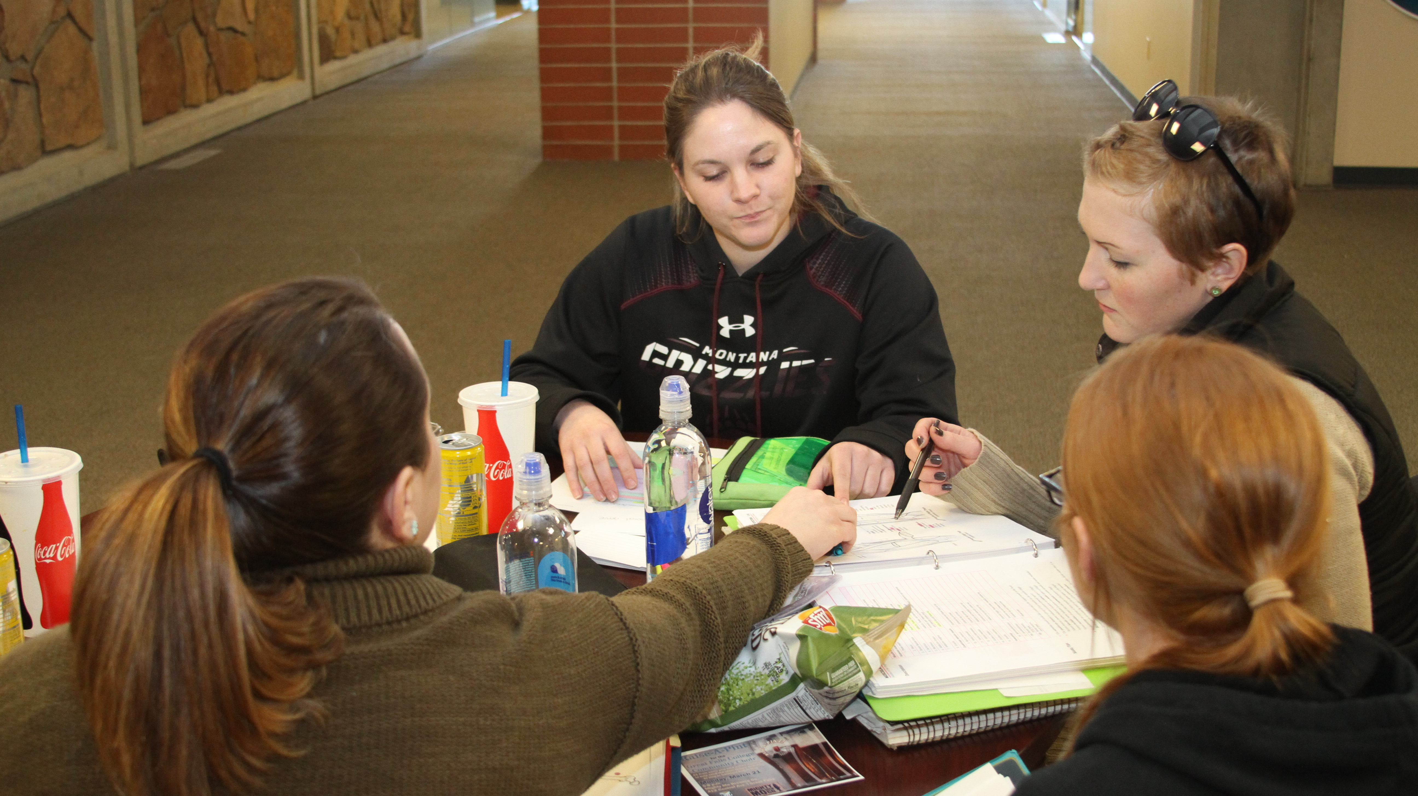
EASING IN
Benefit
Benefit from the best of both worlds. DE students have access to resources at their high school and college.
Experience
Experience the rigor of college classes without the traditional risks.
Gain
College support – instructors, free tutoring services, library services, and an advisor to help them with the process.

Slide 6
Dual Enrollment = Student Success Recent state data says…
Compared to students who do not participate in dual enrollment, MUS DE students outperform their peers in:
Retention: 16% higher rate of first-year college retention (84% DE, 68% non-DE)
GPAs: Higher college freshman GPAs (3.1 DE, 2.8 non-DE)
Credits: More credits earned in first year of college

Slide 7
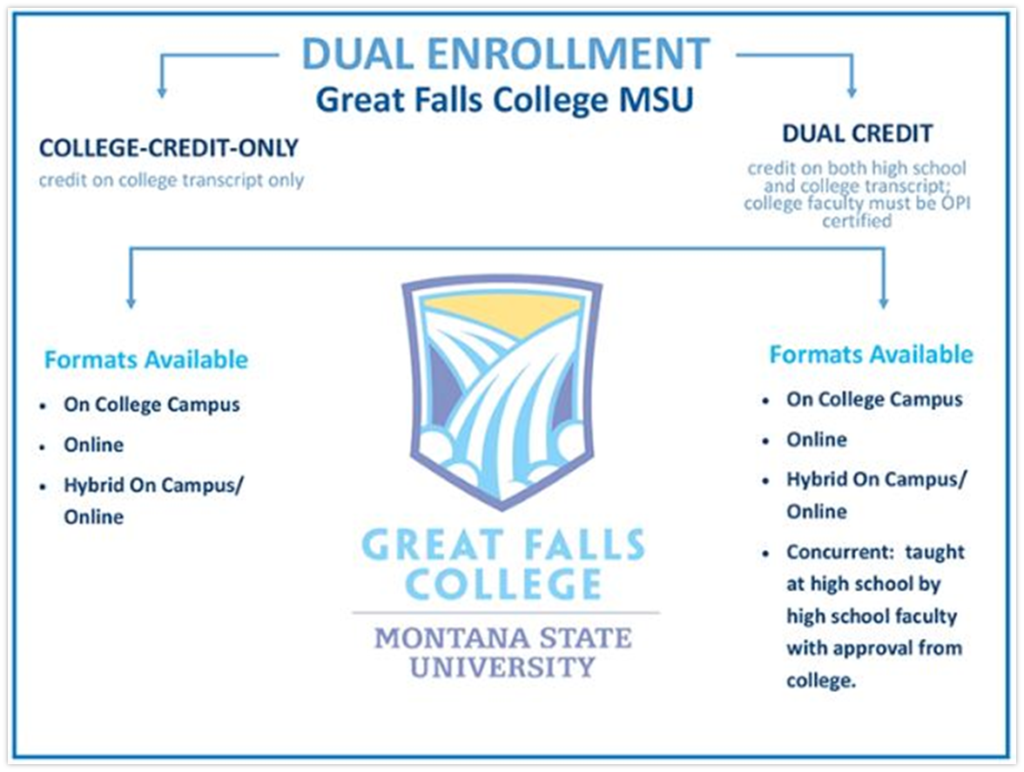
TYPES OF DUAL ENROLLMENT AND COURSE MODALITIES

Slide 8
On-Site Courses
Take classes in person at GFC MSU campus;
Most courses are technology enhanced, giving students access to high-quality instruction & resources
Works best for:
Local / GFPS students
Homeschool students
Rural students (within driving distance)

Slide 9
ONLINE COURSES
“True” Online – Can be taken anywhere with no scheduled meeting times!
Online courses are not self-paced but do offer flexibility for busy people
Many instructors offer optional virtual help sessions for students who want extra support
Live Online –100% online using video conferencing tools on scheduled days/ times
Students receive live instruction without being in a physical classroom
Instructors and students interact live as if in a traditional classroom but may be conveniently located anywhere
Blended – Combination of reduced live instruction time & the flexibility of online work.
Live portions of the course take place on scheduled days/times, either on-site or live online
Rest of the class time takes place entirely online.
Hyflex – Most flexible course model – students choose how they attend and participate.
Join the scheduled time in-person on campus
Participate fully online if attending the live sessions is not an option
Some classes offer live online participation through video conferencing

Slide 10
CONCURRENT COURSES
High school classes taught by high school teachers who meet college credential requirements
Already part of the student’s regular high school schedule
Often offered as both dual credit and advanced placement (AP)

Slide 11
Every year… Request to Teach
Meet the deadlines!
GFPS Deadline:
For all (fall, spring, full-year) classes is November 1 every year
Non-GFPS Deadlines:
For Fall classes is April 1
For Spring & Full Year classes is October 15

Slide 12
Preparing for Your Course
Training
Attend any required concurrent teacher training at GFC MSU; contact us about any questions/concerns you may have prior to the class starting.
LOA
Make sure you have signed and returned your LOA.
Course Syllabi
Finalize all course syllabi and submit to relevant college department.
Student Registration Process
The DE Coordinator will contact you and/or the high school counseling office to coordinate information and registration after the start of semester.
Rosters
After registration is completed, you will receive a class roster and other important info from our Registrar’s Office. The college will also send a letter to your high school administrator.

Slide 13
Teaching the Course
MAKE SURE TO REVIEW YOUR CLASS ROSTER FOR ACCURACY. Contact us if there are issues.
If a student is failing or stops attending, contact the DE coordinator to help with the drop/withdrawal process.
As the last day approaches, The Registrars office will contact you about the student evaluations process.
Once the course ends, grades will be due to our Registrars office. You will receive instructions on how to report grades. You may also need to submit final assessments to the college.

Slide 14
Being a College Instructor
Teaching dual credit classes means you are a college instructor
Montana Board of Regents Policy on credentials
Policy 730 Personnel
College department chair
Departmental policies
Teaching materials
Evaluations
College course outcomes
Maintaining accreditation
Students receive college credit for the class
Expect college-level work
Students will have a college transcript

Slide 15
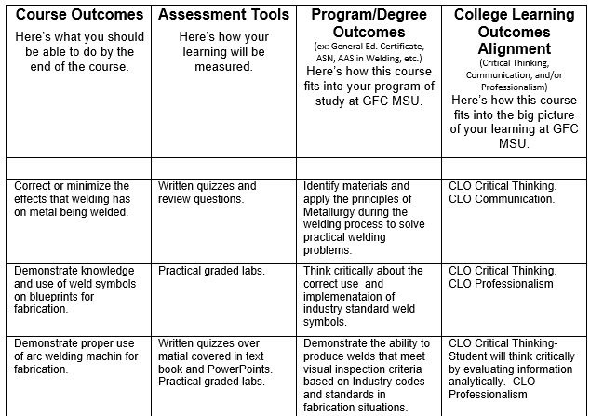
Aligning High School and College Courses
Focus on the outcomes
Common Course Numbering
Work with your college department chair
Outcomes alignment chart

Slide 16
The Syllabus: A Contract with Our Students
Use the college syllabus template
Submit to the division admin before the first day of class
Use college course name, description & outcomes
Include grading scale, late work policy and other important information for the student to know
Do what your syllabus says you’ll do
Dual credit students have access to all of the college’s and the high school’s resources
Dual credit students must follow all of the college’s and the high school’s rules

Slide 17
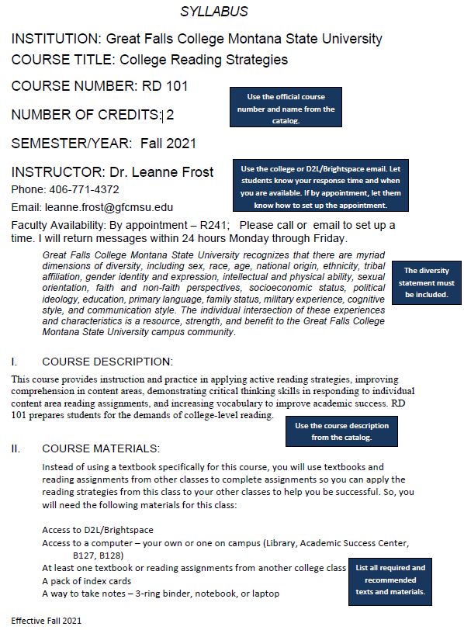

Slide 18
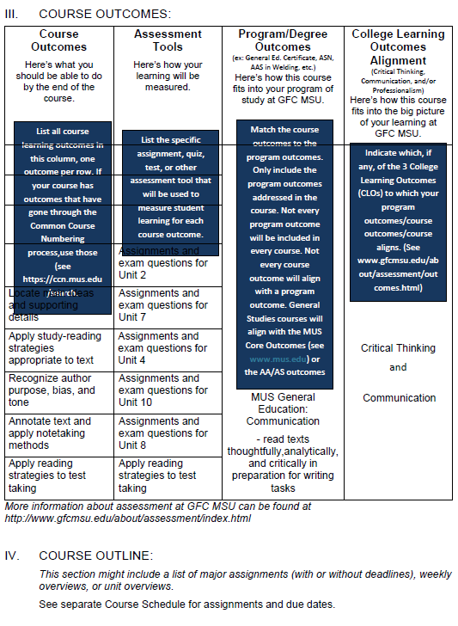

Slide 19
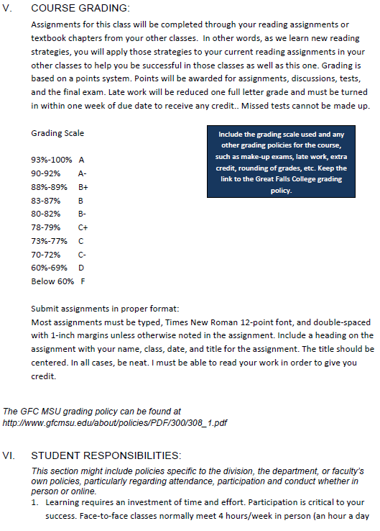

Slide 20
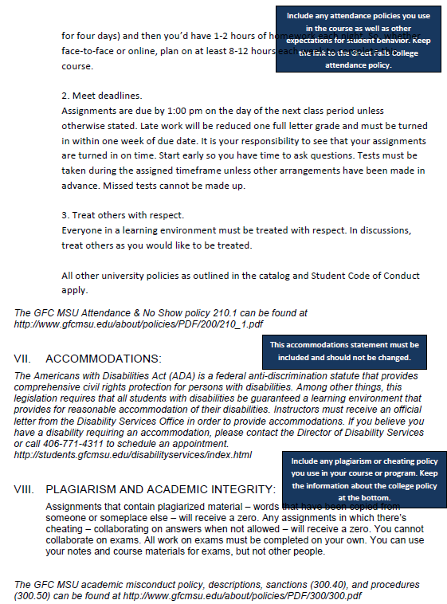

Slide 21
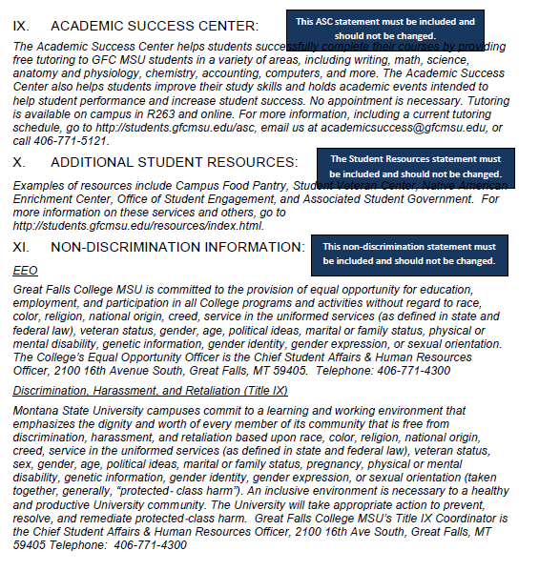

Slide 22
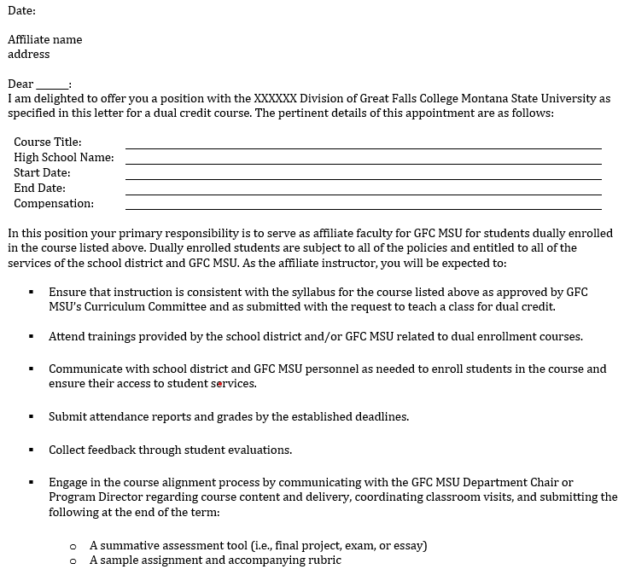
Meeting Expectations: The Contract -Letter of Appointment (LOA)

Slide 23
Compensation
School district pays for the instruction
College provides a stipend for meetings and paperwork
$500 for 1st class
$275 for each additional class

Slide 24
Teaching More than Just the Content
Teaching a dual enrollment course is an opportunity to prepare students for college, the workforce, and life
Foster independence
Encourage personal responsibility
Provide opportunities for growth

Slide 25
Questions?
Questions?
Shannon Marr, Director of Recruitment & Enrollment
406-771-4408
shannon.marr1@gfcmsu.edu
Leanne Frost, Executive Director of Instruction & Student Success
406-771-4372
leanne.frost@gfcmsu.edu

